Slide 1
Predicting best Suburb for a new Café in Melbourne Australia

Slide 2
There are plenty of competiton in Melbourne for hospitality. And every year thousands of new places open up and again thousand go bankrupt

Slide 3
Data
Postcodes, suburbs are scraped from Wikipedia
Coordinates are pulled from GeoPy
Venue types are pulled from Foursquare API

Slide 4
Finding suburbs similar to Brunswick for investing in a new café:
Methodology
Using all venues in the city, and creating a frequency of occurency of a venue type
Using the real estate prices to find a similar customer segment

Slide 5
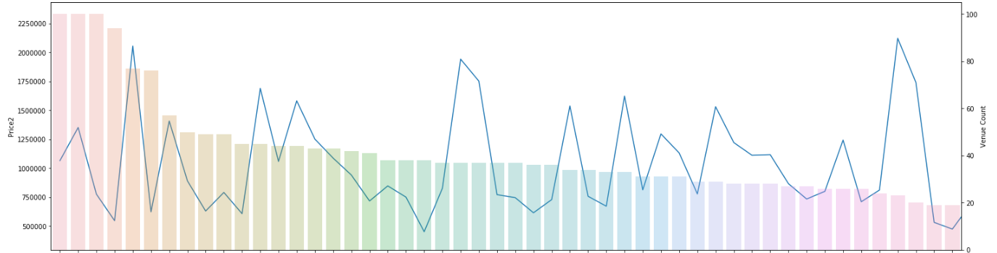
Using machine learning to predict best spots for a new cafe
With the hyperdimensionality of features of a city, there are no easy ways to find the best places to invest in for a café.
Below table shows the real estate pricing v number of venues in Melbourne Australia

Slide 6
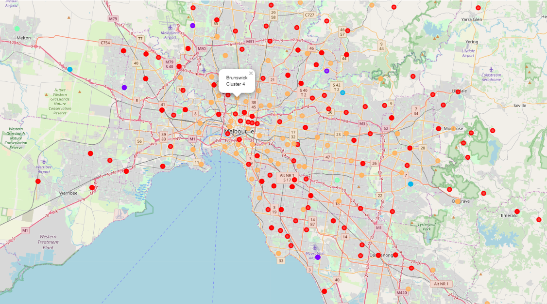
Unsupervised learning clusters of Melbourne based on the frequency of venue types

Slide 7
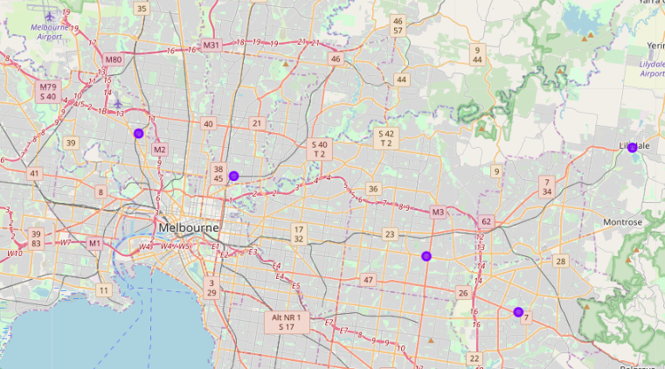
Top recommendation points for investing in a new cafe
Conclusion

